Slide 1
Backpropagation
Jack Wu

Slide 2
Now. How to train a MLP model?
MLP utilizes a supervised learning technique called Backpropagation for training.

Slide 3
Supervised Learning
We will distinguish the differences between supervised and unsupervised learning.
Supervised Learning uses pre-labeled data. We can understand it as “Learning from mistake”.
Unsupervised Learning uses data without labels, and we can think of it as “Figure out the pattern”.

Slide 4
Backpropagation
Backpropagation is a common practice in modern machine learning model training.
We use backpropagation along with optimizers, like the most famous gradient decent optimizer.
Backpropagation is supervised learning, which means the data we input needs to have a “feature” and a “label”.
Like we stated before, backpropagation is basically “learning from mistakes”.

Slide 5
How it Works
When training, we split the dataset into smaller training sets.
We use backpropagation to train on each set of data.
Goal: Repeat propagate and weight update process until loss converges.

Slide 6
Flowchart for Backpropagation.
Dataset
Data
Pre-Processing

Slide 7
Propagate
It simply means input data into the ML model and the model splits out a prediction.
Step 1: Input features into ML model.
Step 2: After the model finishes its calculating, it splits out an output.

Slide 8
Flowchart for Backpropagation.
Dataset
Data
Pre-Processing
Features
1. The model receives input from features.
Predict
2. The model makes a prediction.
Output

Slide 9
Flowchart for Backpropagation.
Dataset
Data
Pre-Processing
Features
1. The model receives input from features.
Predict
Loss
2. The model makes a prediction.
3. Calculate Loss using Loss Function.
Output
Loss Function
Label

Slide 10
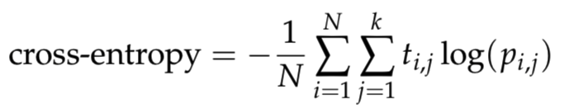
Loss Function
Loss function helps us to determine how different between the model’s prediction and the true label.
A very common loss function is Cross Entropy.

Slide 11
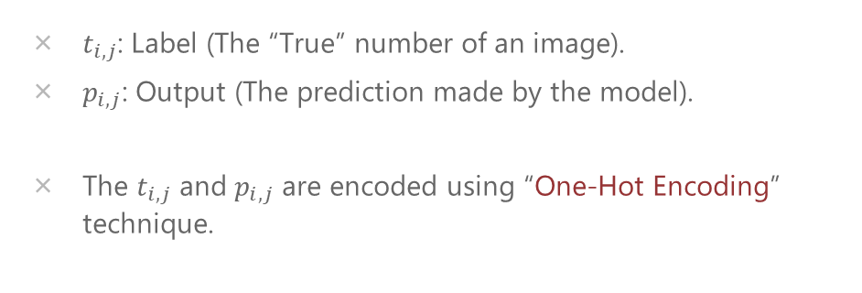
Cross Entropy
$t_{i,j}$: Label (The “True” number of an image).
$p_{i,j}$: Output (The prediction made by the model).
The $t_{i,j}$ and $p_{i,j}$ are encoded using “One-Hot Encoding” technique.

Slide 12
One-Hot Encoding
Simply means use the index of an array to mark the true label.
For example, to represent the number 4 in 10 possible outputs:
[0, 0, 0, 1, 0, 0, 0, 0, 0, 0]
Output: [0.2, 0.1, 0.1, 0.9, 0.3, 0.4, 0.2, 0.1, 0.2, 0.1] (Possibilities)
Label: [0, 0, 0, 1, 0, 0, 0, 0, 0, 0] (Represents 4)

Slide 13
Flowchart for Backpropagation.
Dataset
Data
Pre-Processing
Features
1. The model receives input from features.
Predict
Loss
2. The model makes a prediction.
3. Calculate Loss using Loss Function.
Output
Loss Function
Label

Slide 14
Flowchart for Backpropagation.
Dataset
Data
Pre-Processing
Features
1. The model receives input from features.
Predict
4. Optimizer updates weight and bias.
Optimizer
Loss
2. The model makes a prediction.
3. Calculate Loss using Loss Function.
Output
Loss Function
Label

Slide 15
Optimizer
Basically an optimizer uses a algorism to find out a combination between weight and bias that minimizes the loss.
We usually use a method called SGD(Stochastic Gradient Descent) to minimize loss.

Slide 16
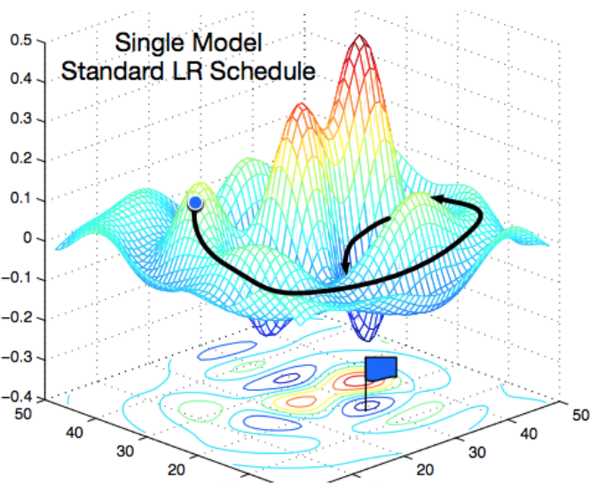
Stochastic Gradient Descent
Goal: Minimize Loss.
SGD simply means that descent one step on the direction with the largest slope at that point, until reach a minimum of loss.
Think of it like a hiker that tries to descent from the top of the mountain to the bottom in a heavy fog. He cannot see far away, so every step he simply follows the direction that looks like has the largest downward slope, and he will eventually reach the bottom of the hill.
Image Credit: https://medium.com/38th-street-studios/exploring-stochastic-gradient-descent-with-restarts-sgdr-fa206c38a74e

Slide 17
Weight Update
Simply means to learn from mistakes.
Step 1: Use loss function to calculate the difference between the prediction(output) and the label. i.e. calculate the loss.
Step 2: Update the weight and bias. Goal: Minimize the loss.

Slide 18
Flowchart for Backpropagation.
Dataset
Data
Pre-Processing
Features
1. The model receives input from features.
Predict
4. Optimizer updates weight and bias.
Optimizer
Loss
2. The model makes a prediction.
3. Calculate Loss using Loss Function.
Output
Loss Function
Label

Slide 19
END

